Slide 1





Make Data Count Summit
September 12-13, 2023
University of California, Washington Center (UCDC)
#mdcsummit
@makedatacount
@makedatacount@openbiblio.social
iratxe.puebla@datacite.org

Slide 2
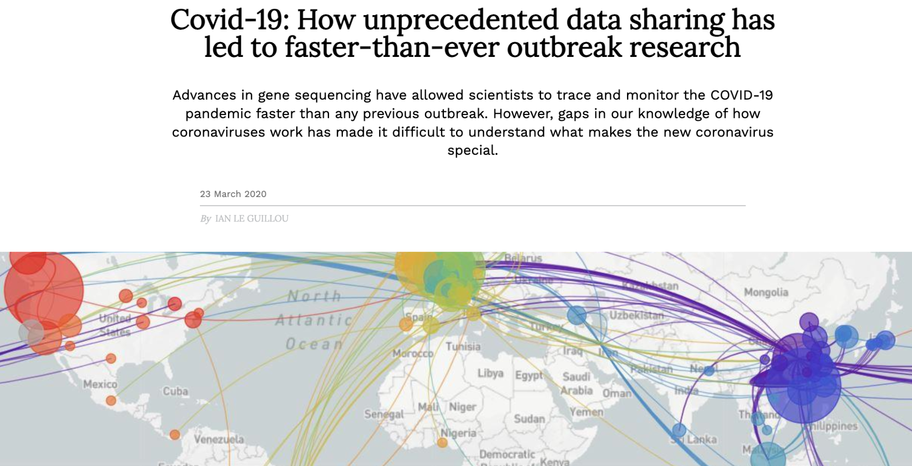
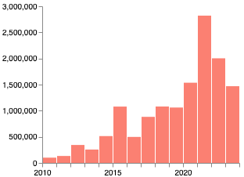
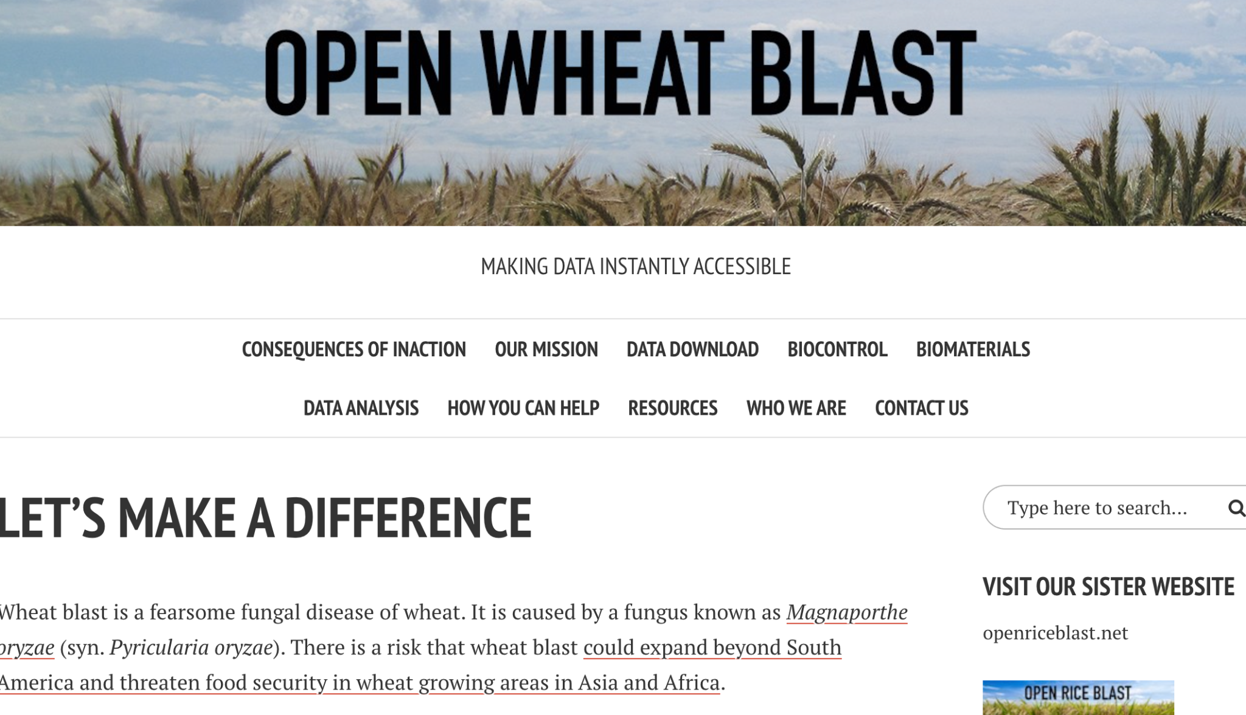
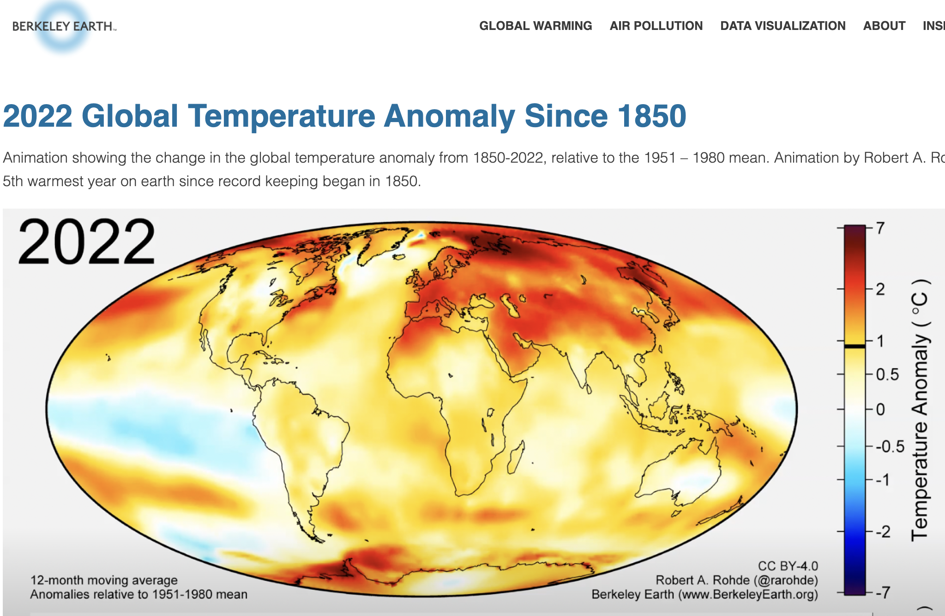
Data sharing is valuable
Data sharing has increased dramatically over the last 10 years supported by
National & funder policies
Infrastructure
Standards
Datasets in DataCite Commons

Slide 3
Understanding the value of data sharing
To nurture and incentivize data sharing we need to assign value to it
How is shared data used? By whom & for what purposes?
What is the impact of open data, for policy making, scientific discovery and societal benefit?
What is the return on investment on open data?
Understanding the investment, reach, and impact of open data requires transparent and responsible data metrics.

Slide 4
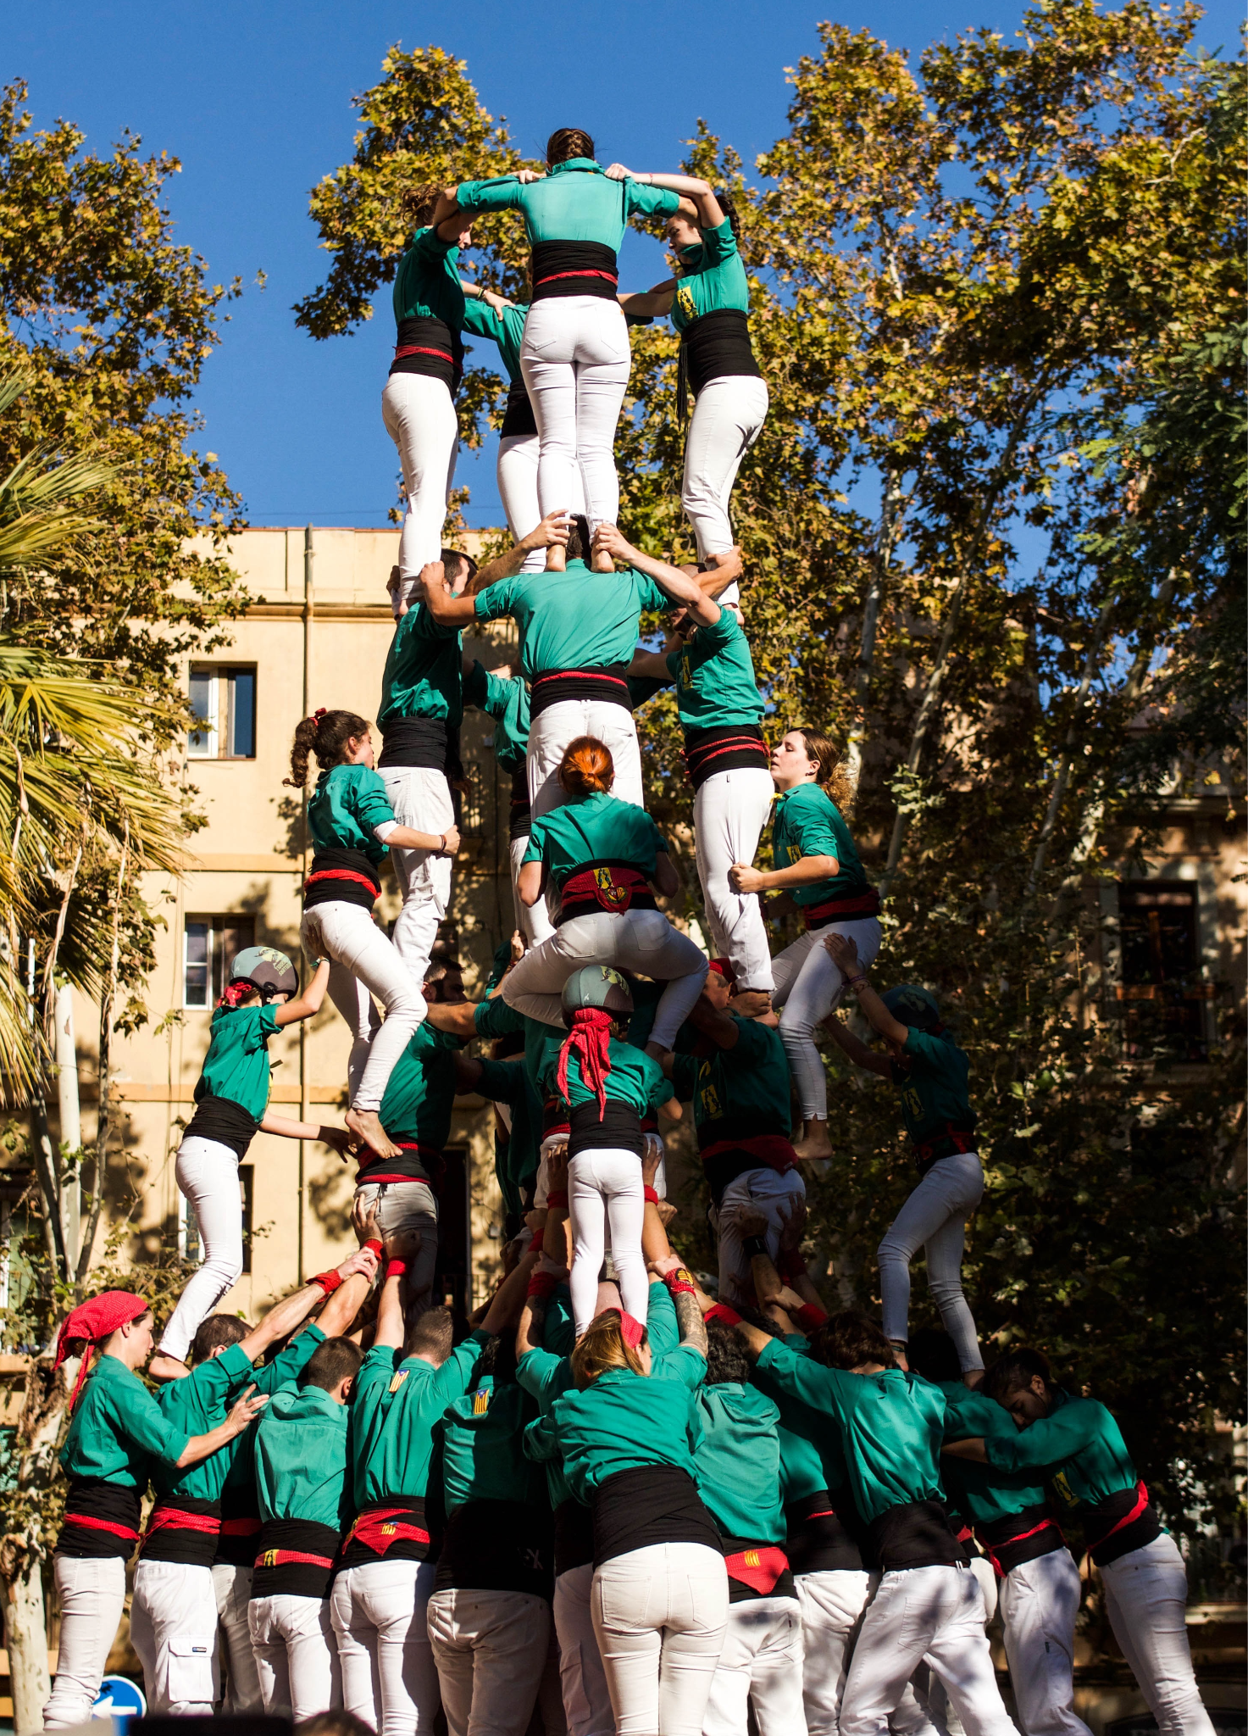
Data metrics are a community effort
The foundation for transparent and responsible data metrics
Driven by community standards
Supported by open infrastructure
Contextualized through evidence
Make Data Count seeks to catalyze diverse data communities and convene stakeholders to prioritize and support the development of data metrics.
Image by Andrea Huls Pareja via Unsplash

Slide 5
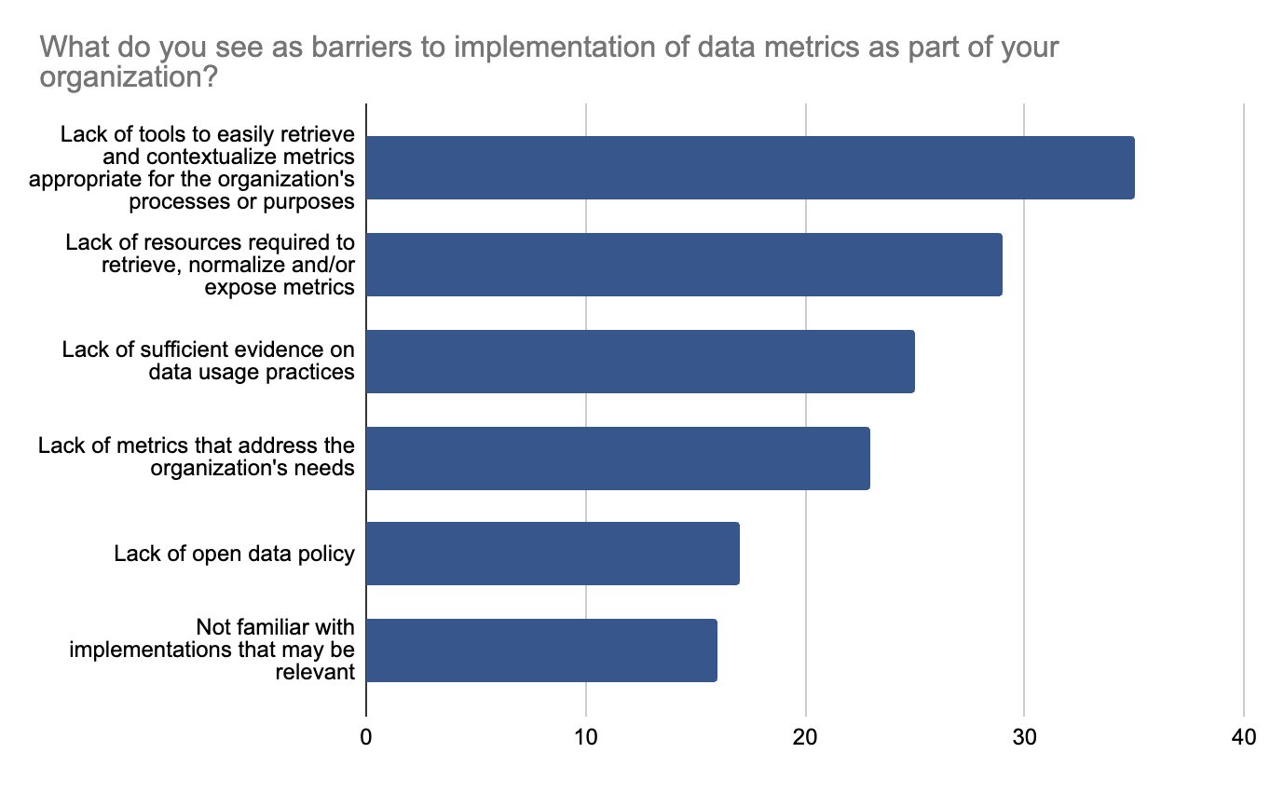
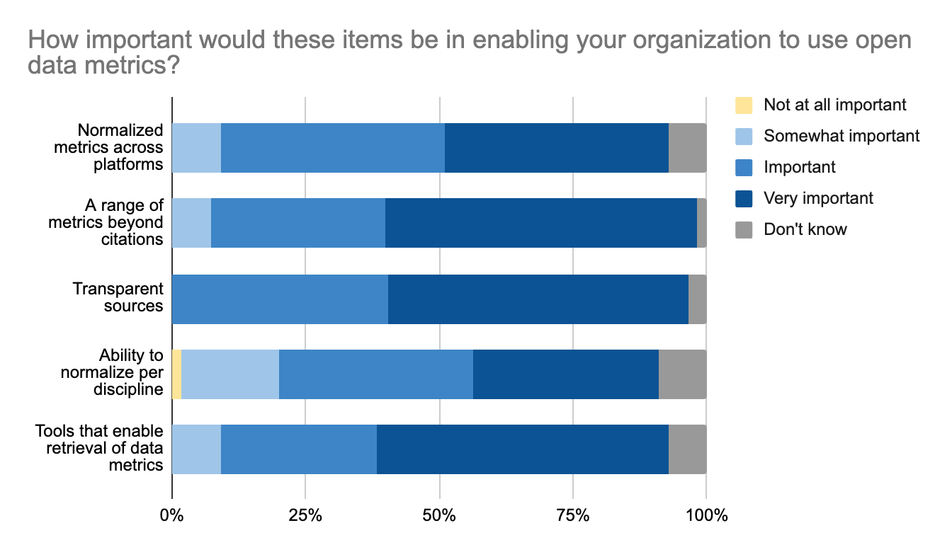
Survey - Thank you for sharing your feedback
Gain a holistic view of the impact of research projects, and of return-on-investment
Inform decisions on resource allocation, funding, cross-agency collaboration
Improve metadata to make connections between data and other outputs
Update evaluation processes
Standardize metrics

Slide 6
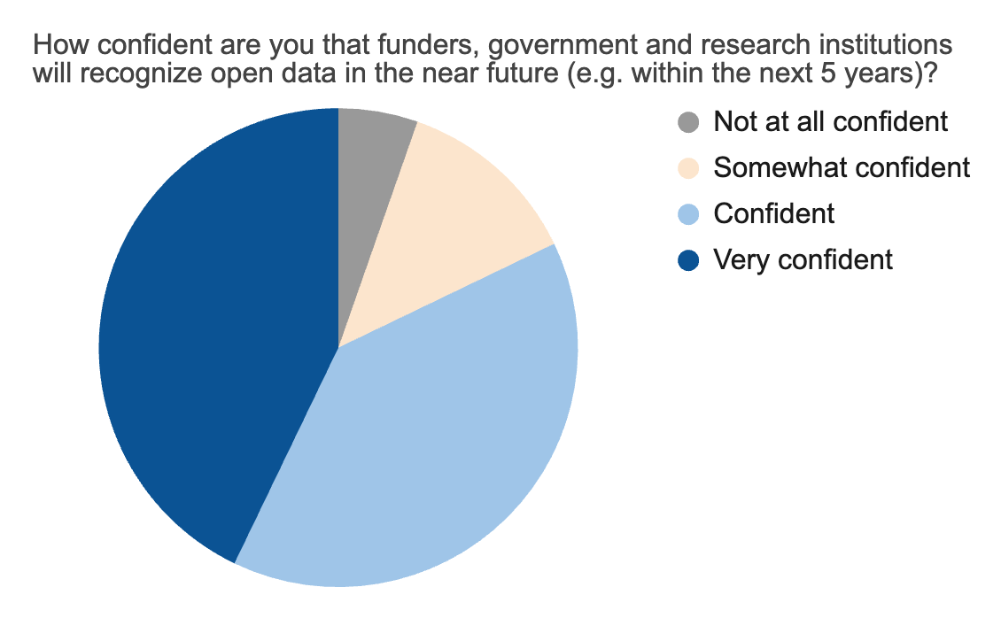
Let’s build on this momentum - but also mind the gap
Social sciences & humanities
Researchers, and early career researchers in particular
Minority-serving and non-R1 institutions
Patients, those involved in citizen & community science
Stakeholders from geographical locations beyond US & Europe

Slide 7
Meeting scope & goals
Actionable items agencies and institutions can take as part of their guidance, processes or infrastructure to advance the evaluation of data usage
Build on what is already available
Focus on what can be achieved short/mid term
How to we assign value to open data?
What tools, processes and policies will advance meaningful metrics?

Slide 8

Defining the Need for Open Data Metrics
Daniella Lowenberg
University of California Office of the President

Slide 9
Defining the Need for Open Data Metrics
Daniella Lowenberg @danilowenberg

Slide 10







What am I here reppin’?

Slide 11

Strolling through the data metrics journey
2015
2017-2020
2021
2022
2023
Making Data Count
Imagine a world…
This much we know is true…
If resources were limitless…
Shifting focus

Slide 12
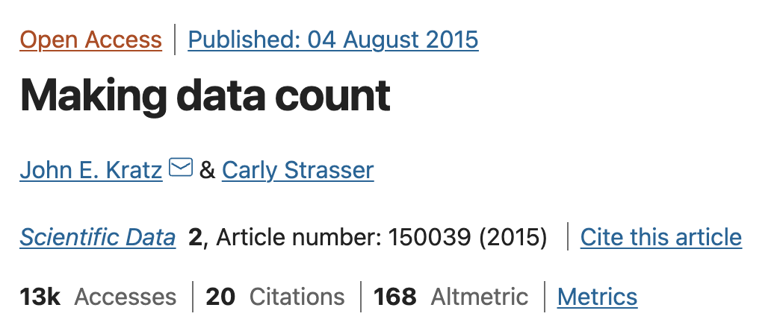

2015
Making Data Count

Slide 13
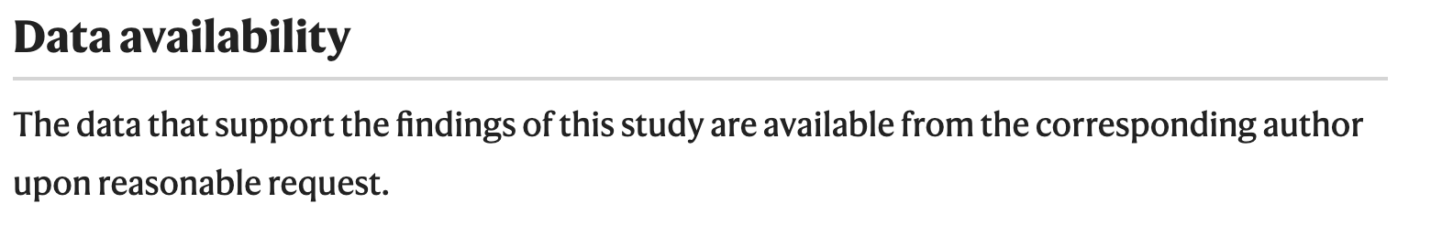
2015
Everyone else

Slide 14


And so we learned
Scholarly communications ecosystem needs baseline data usage and citation infrastructure

Slide 15
Strolling through the data metrics journey
2015
2017-2020
2021
2022
2023
Making Data Count
Imagine a world…
This much we know is true…
If resources were limitless…
Shifting focus

Slide 16
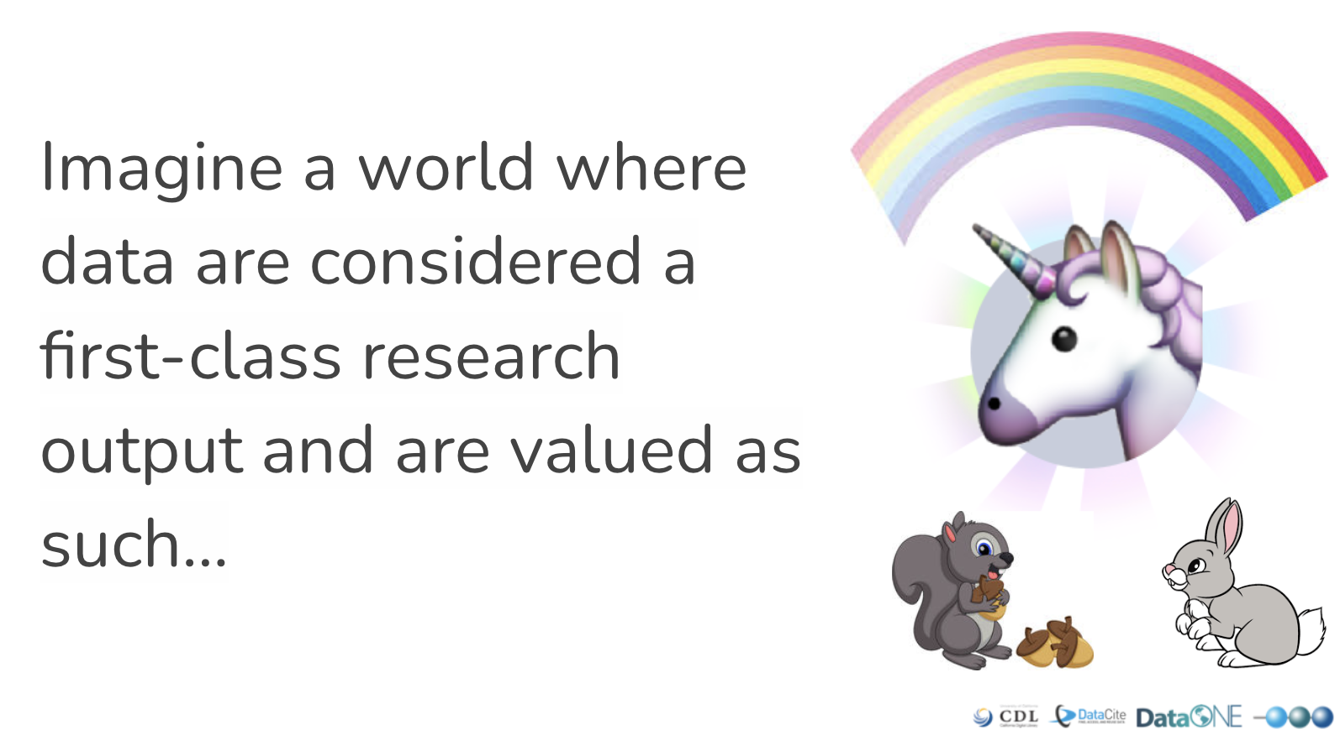
2017-2020
Make Data Count

Slide 17
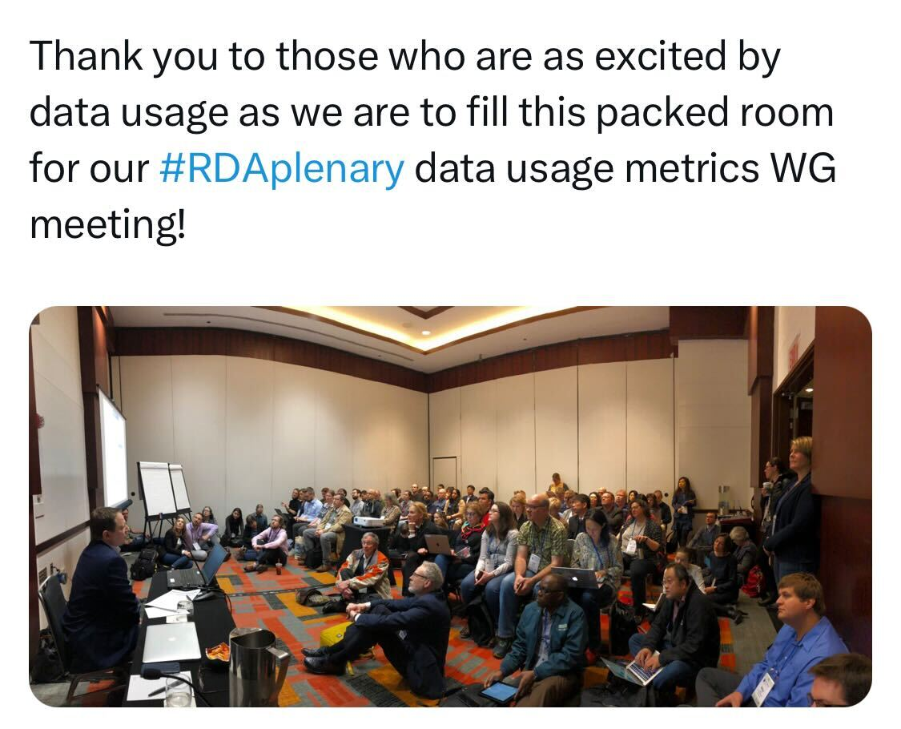
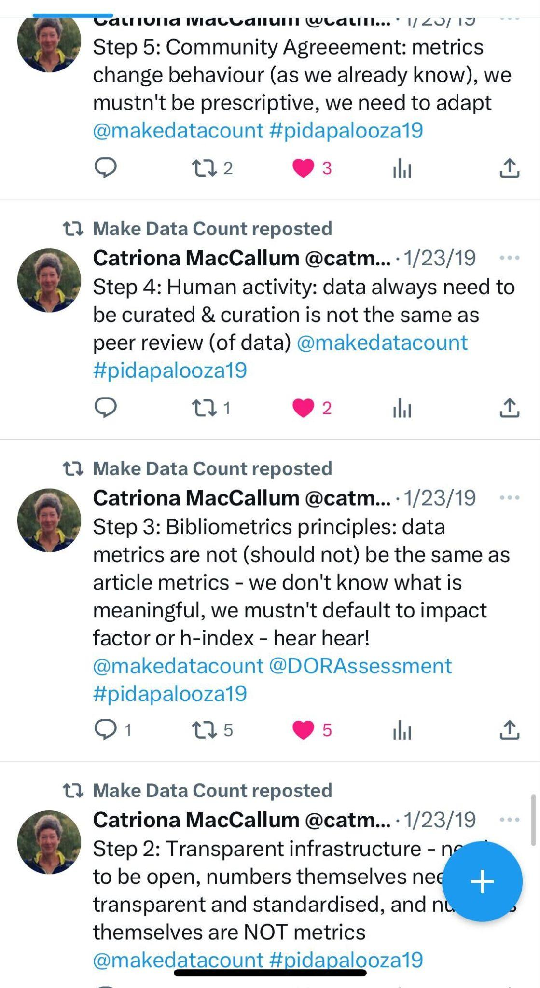
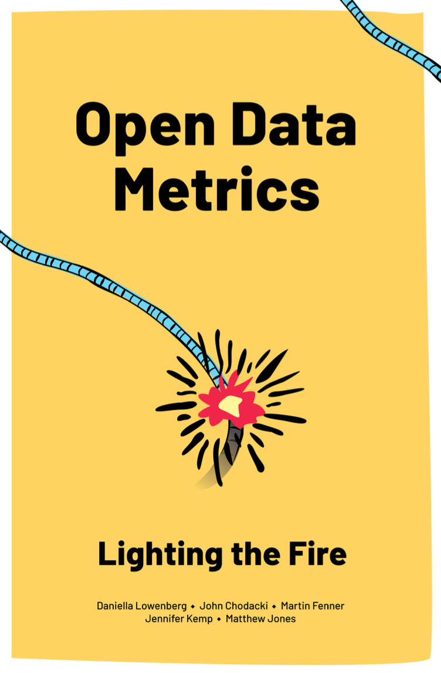
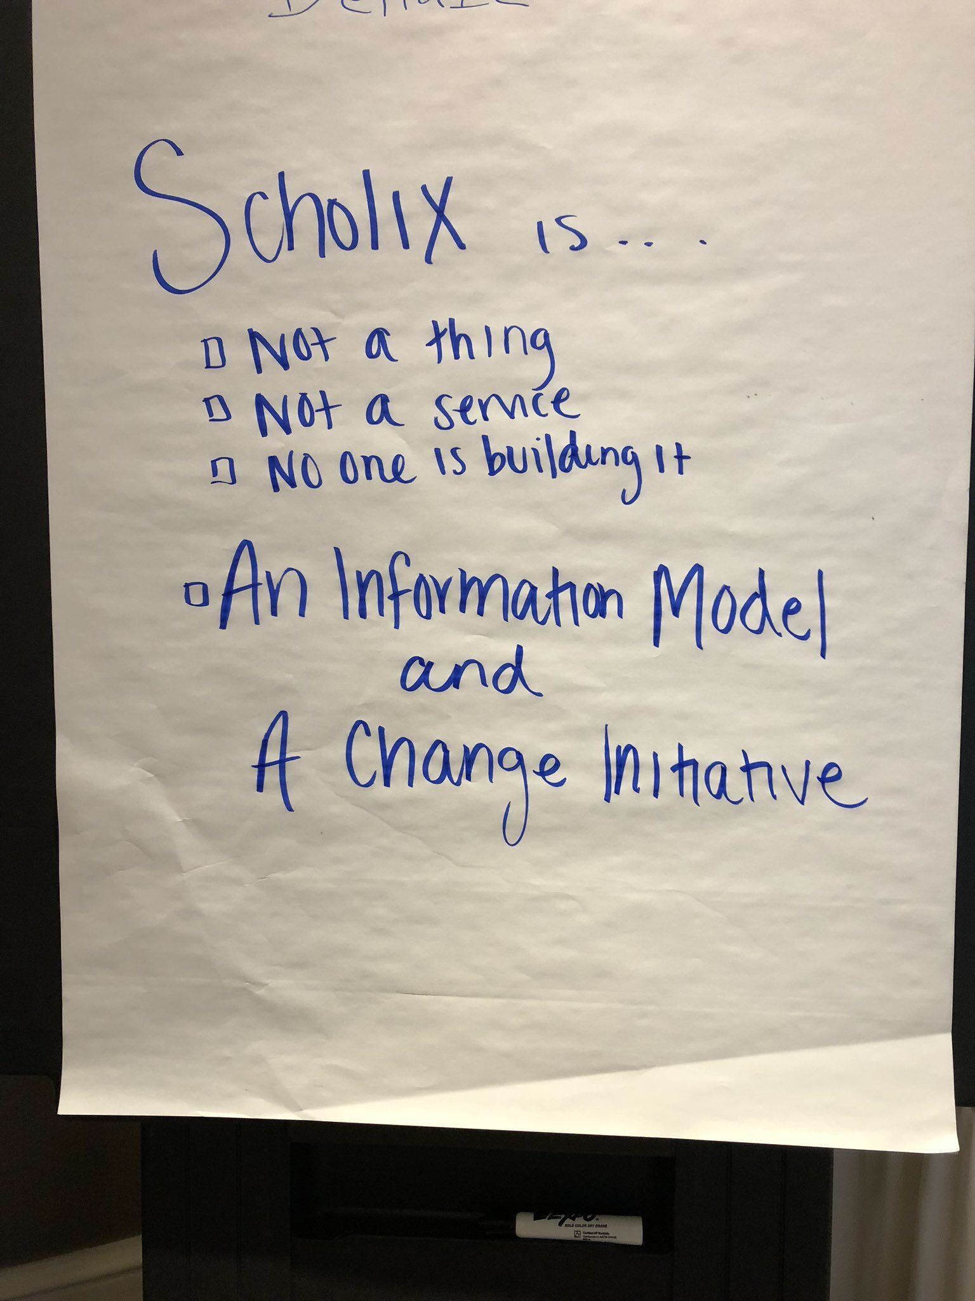
2017-2020
Make Data Count

Slide 18
2017-2020
Right time, wrong conversations
We do data citations? But how do I do data citations?
We need perfect infrastructure!
Data citations are credit for data!

Slide 19


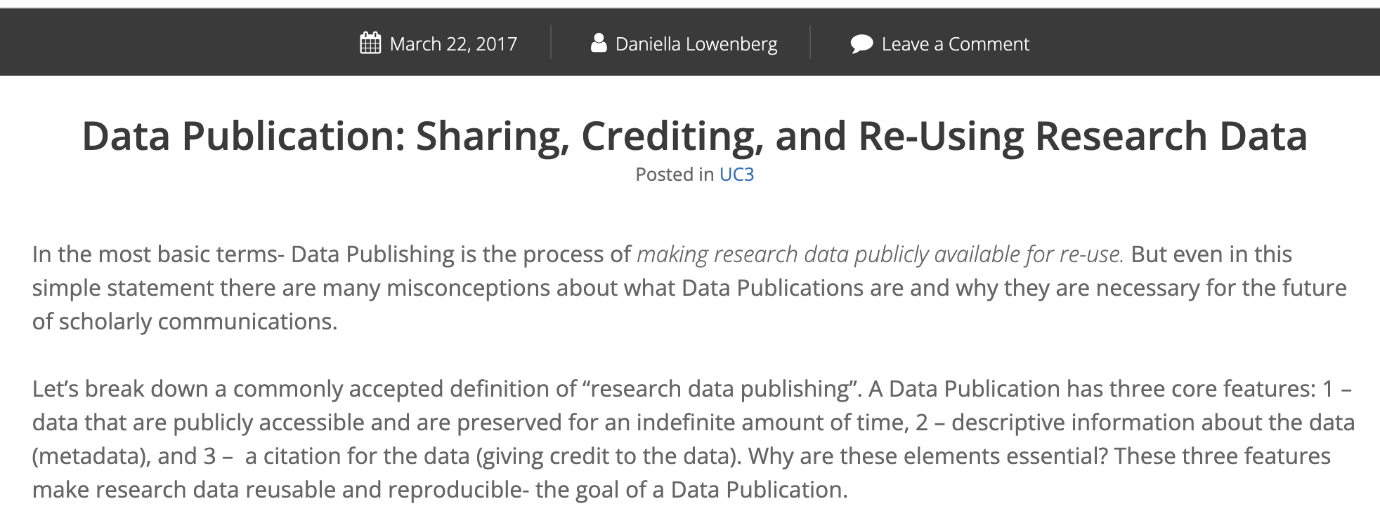
2017-2020

Slide 20
And so we learned
We have to stop focusing on altering publisher behavior
We need bibliometrics studies
We need to emphasize what can be done right now

Slide 21
Strolling through the data metrics journey
2015
2017-2020
2021
2022
2023
Making Data Count
Imagine a world…
This much we know is true…
If resources were limitless…
Shifting focus

Slide 22
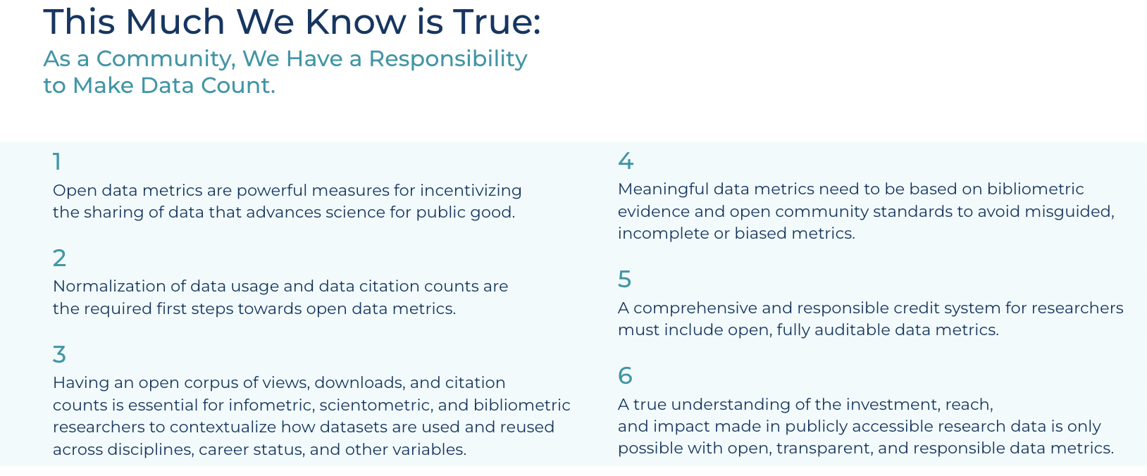
2021
Make Data Count

Slide 23
And so we learned
Facts aren’t compelling enough to outweigh lack of patience
Web scraping and NLP must be used to expedite data citation

Slide 24
Strolling through the data metrics journey
2015
2017-2020
2021
2022
2023
Making Data Count
Imagine a world…
This much we know is true…
If resources were limitless…
Shifting focus

Slide 25

2022

Slide 26
And so we learned
The corpus has to be used by diverse stakeholders, be broadly understood, and serve as a trusted source across all interested sectors

Slide 27
Strolling through the data metrics journey
2015
2017-2020
2021
2022
2023
Making Data Count
Imagine a world…
This much we know is true…
If resources were limitless…
Shifting focus

Slide 28

Looking at Open Data Metrics Through a Different Lens
Step 1
Step 2
Step 3
Step 4
Step 5

Slide 29







The importance of building trust
Complete
Transparent
Auditable
Contextualized
Open Data Metrics
Metrics Source Data
e.g., usage, citations, etc.

Slide 30
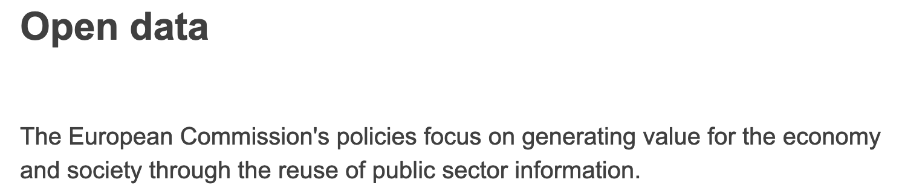
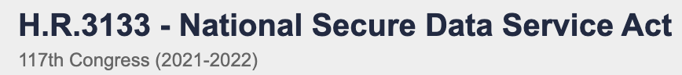



In So Many Ways
We are where we want to be

Slide 31

In So Many Ways
We are NOT where we should be
Data Availability Statements
Overhyping incentives
“The need for open data”

Slide 32
2023
Everyone else

Slide 33

It’s time for a
new conversation

Slide 34
Prioritizing Open Data Metrics
Data metrics are the priority for infrastructure, funding, policy, discussion, across our spaces. We need evidence-based ways to evaluate how effective our investments in open data have been, what data should be opened up, and indicators to reward researchers and administrators for data reuse

Slide 35

We Made it to the Summit
Embrace evidence & bibliometrics
Let’s commit to…
Use shared infrastructure
Invoke principles through all components of data metrics

Slide 36
Sept 12 2023
Questions?
daniella.lowenberg@ucop.edu @danilowenberg

Slide 37

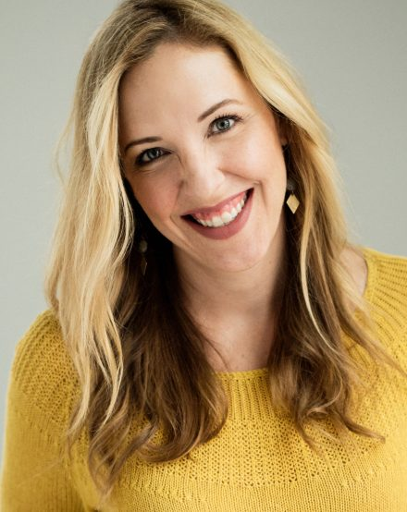
Open Global Data Citation Corpus
Matt Buys
Executive Director, DataCite
Carly Strasser
Program Manager for Open Science, Chan Zuckerberg Initiative

Slide 38




Forging the path forward
Global Data Citation Corpus
Matt Buys, Executive Director, DataCite
Patricia Brennan, Vice President Technology, Science, Chan Zuckerberg Initiative
Carly Strasser, Senior Program Manager for Open Science, Chan Zuckerberg Initiative

Slide 39
Data Citation Corpus
Building a community corpus

Slide 40
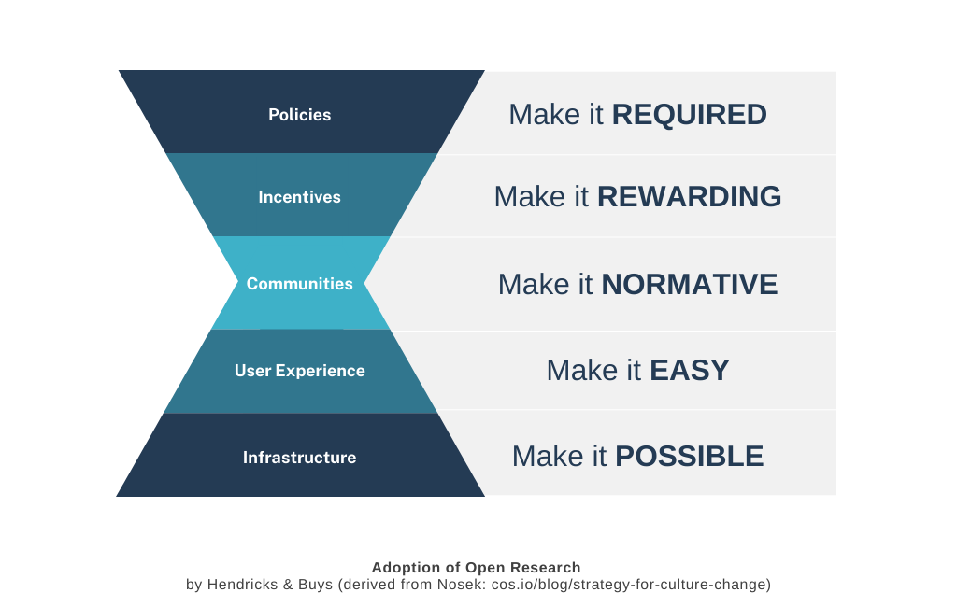
Our Collective Action
Driving Culture Change Across the Community

Slide 41
Uniting Data Footprints
Open Global Data Citation Corpus
Challenge: Dispersed Data Reuse Information
Data reuse details spread across various platforms
Hinders understanding of open data impact
Solution: The Global Open Data Citation Corpus
Centralized resource for data citations
Openly available
Aggregates citations from multiple sources
Enhances community accessibility

Slide 42

Uniting Data Footprints
Open Global Data Citation Corpus
Stakeholder Advantages
Researchers: Insights into data impact
Funders: Evaluation of research data reach
Institutions: Understanding data reuse trends
Enabling Large-Scale Analyses
Empowers extensive research analyses
Provides evidence of research data reuse practices
Offers insights spanning disciplines and institutions

Slide 43
Collaborating to Build the
Open Global Data Citation Corpus
CZI Science

Slide 44

CZI SCIENCE GOALS
80 YEARS
Cure, prevent, or manage all diseases by the end of the century.
10 YEARS
Advance research and develop technologies to measure human biology in action: Understanding the mysteries of the cell and how cells interact in systems.

Slide 45



CZ Science Approach
WE FUND
Grant Programs
WE DO
CZ Biohub Network
We fund scientific programs globally to advance biomedical research.
We work closely with scientists and engineers at our partner institutions - CZ Biohubs, the Kempner Institute, and CZII.
WE BUILD
CZI Science Tech
We build and democratize next-generation software and hardware tools.

Slide 46

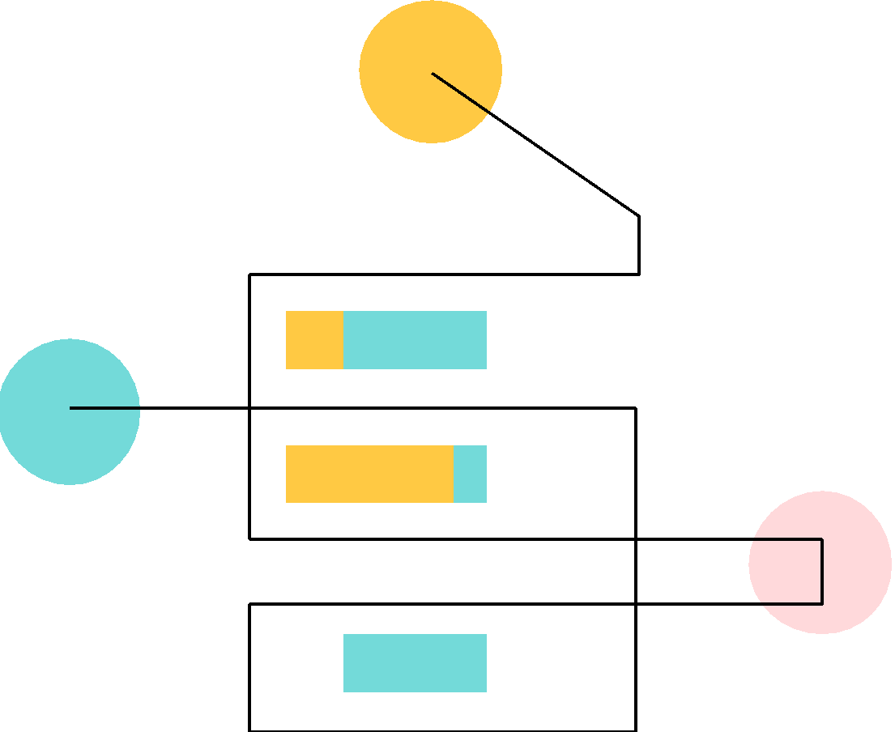



CZI Sci-Tech: BUILD
Software tools
Data projects
Software Mentions Dataset
Standardized & integrated single-cell datasets
Biodata Resource Inventory
Metagenomics analytics platform
CZI Cryo ET Data Portal
Global Data Citation Corpus
Hosted 3D tomograms + annotation

Slide 47
CZI Sci-Tech: BUILD
Software tools
Data projects
Software Mentions Dataset
Standardized & integrated single-cell datasets
Biodata Resource Inventory
Metagenomics analytics platform
CZI Cryo ET Data Portal
Global Data Citation Corpus
Hosted 3D tomograms + annotation

Slide 48
DataCite-CZI Partnership: Workflow
Define “datasets”
Apply ML model to corpus
Extract dataset mentions
Link to a repository

Slide 49
Dataset Definition
A collection of data that have been measured, collected, and/or analyzed as part of a research study. Includes:
Accession Number IDs associated with a database such as GEO, GenBank, or BioProject
DOIs associated with a repository such as Dryad, Zenodo, or Figshare
Resources hosted on external URLs such as academic institutions
Metagenomes from the Gulf of Mexico are available under the NCBI BioProject PRJNA291283. | BioProject database
The microarray data had been previously deposited at Gene Expression Omnibus (GEO) under accession number GSE2603. | GEO
The mass spectrometry proteomics data have been deposited to the ProteomeXchange Consortium via the PRIDE partner repository with the dataset identifier PXD001585. | ProteomeXchange
Examples

Slide 50
Workflow
Define “datasets”
Apply ML model to corpus
Extract dataset mentions
Link to a repository
SciBERT-based Named Entity Recognition
CZI Full-Text,
Europe PMC Full-Text

Slide 51
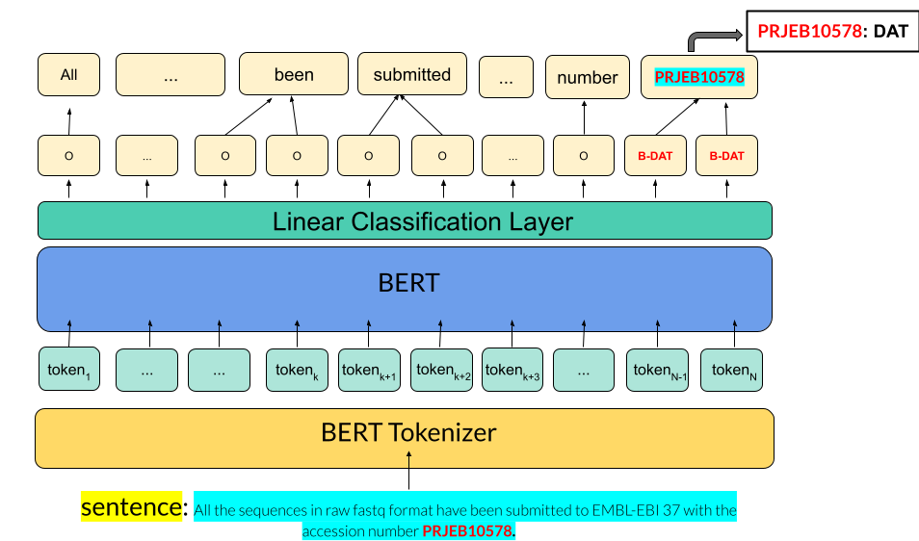
Extract mentions from the literature using ML (NLP) based on their persistent identifiers
Clean, disambiguate, and resolve the mentions
Join them with the full bibliographic record and dataset record
Create a full data citation in the format of standardized, structured metadata
Coming soon -
Open sourcing the model

Slide 52
Paper-dataset links
 | Counts
# full-text papers | ~ 16M
# papers with mentions | ~ 315k
# total dataset mentions | ~ 914k
# unique datasets | ~ 400k
# paper-dataset links | ~ 700k

Slide 53
Our journey together!
Building a community corpus

Slide 54



The Corpus
Data Sources & Access
Source 1
Global Data Citation Corpus
Source 2
Source 3
……

Slide 55
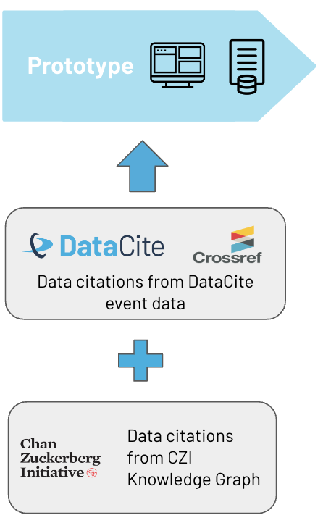
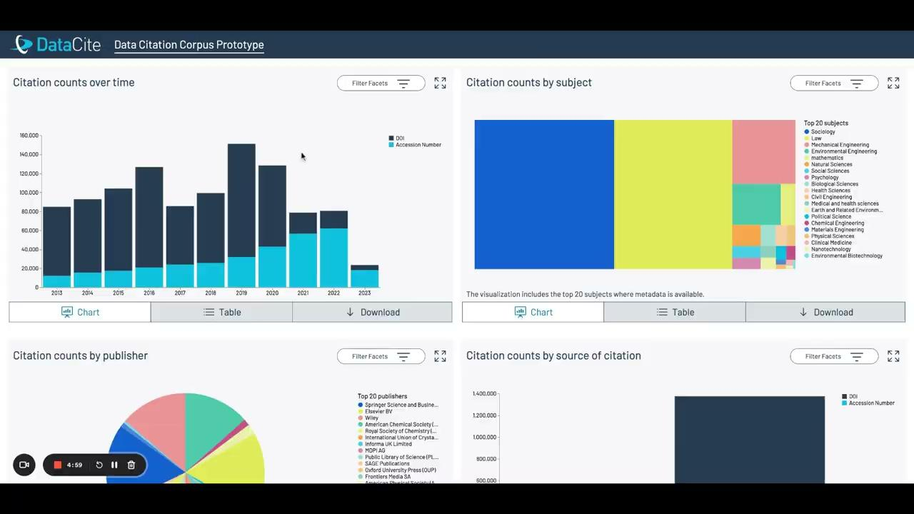
Corpus Prototype
Visualizing the Corpus
https://makedatacount.org/data-citation/
http://corpus.stage.datacite.org/dashboard

Slide 56
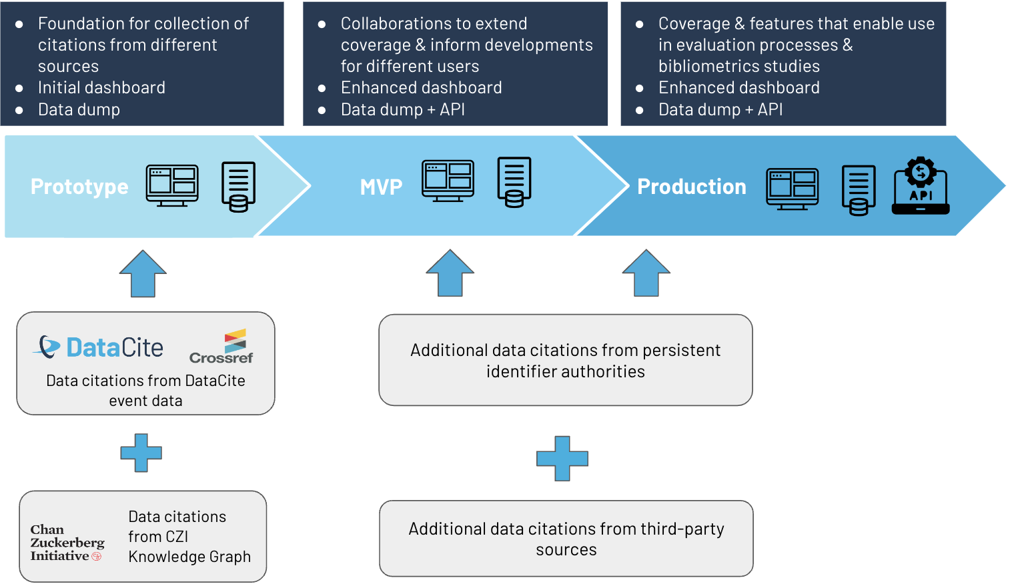
Exciting Journey Ahead
Community Innovation & Collaboration

Slide 57
Future Collaborations

Slide 58
Engaging the Community
Building the Corpus Together
Repositories
Submit citations through DOI metadata
Track and display data citations
Explore integration with DataCite Event Data
Organizations with known Data Citations
Submit citations to the open data citation corpus
Consultations and expressions of interest welcome
Publishers
Include data citations in Crossref metadata deposit
Engage with us in discussions
Guidance available for submission
Institutions and Funders
Potential uses in institutional processes
Providing feedback welcomed
Contact iratxe.puebla@datacite.org to get involved!

Slide 60

Five years since the US Evidence Act
Nancy Potok
CEO, NAPx Consulting
Visiting Scholar, New York University
Visiting Fellow at RTI International

Slide 61
THE FOUNDATIONS OF EVIDENCE-BASED POLICY MAKING ACT AFTER FIVE YEARS
Nancy Potok
Make Data Count Summit
September 13, 2023
Washington, D.C.

Slide 62
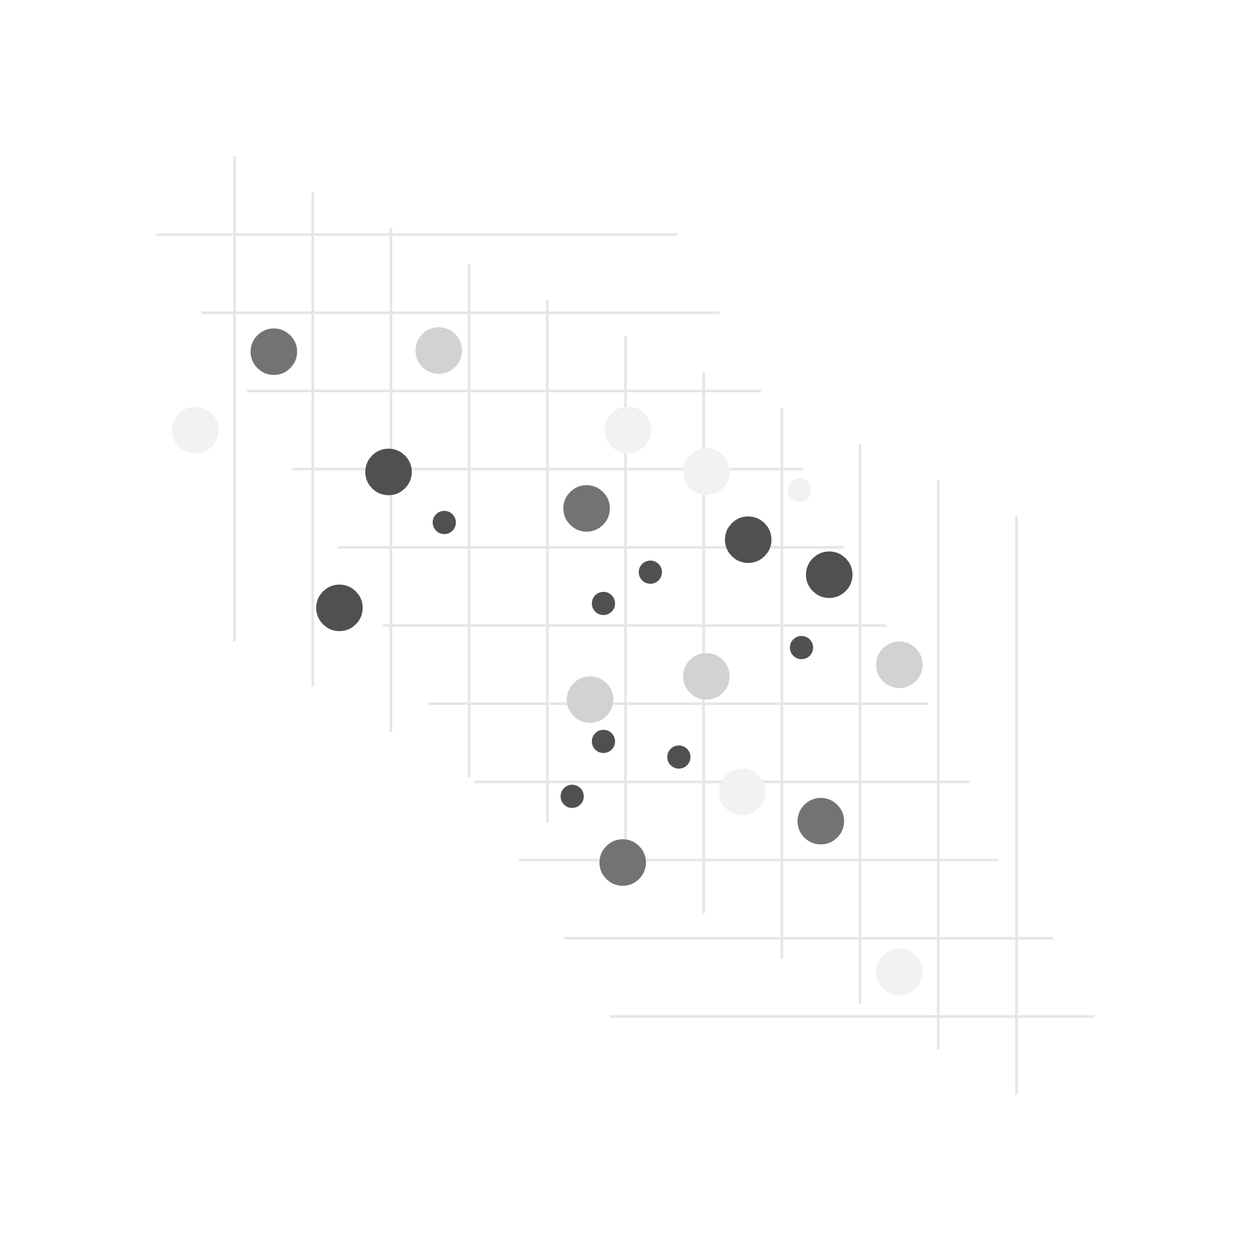
Data Ecosystem
Federal Data Strategy
Foundations of Evidence Based Policy Act
CHIPS and Science Act
Administrative Actions
Data Providers
Data Guardians
Infrastructure Owners
Data Users
Policy Makers
Funders

Slide 63
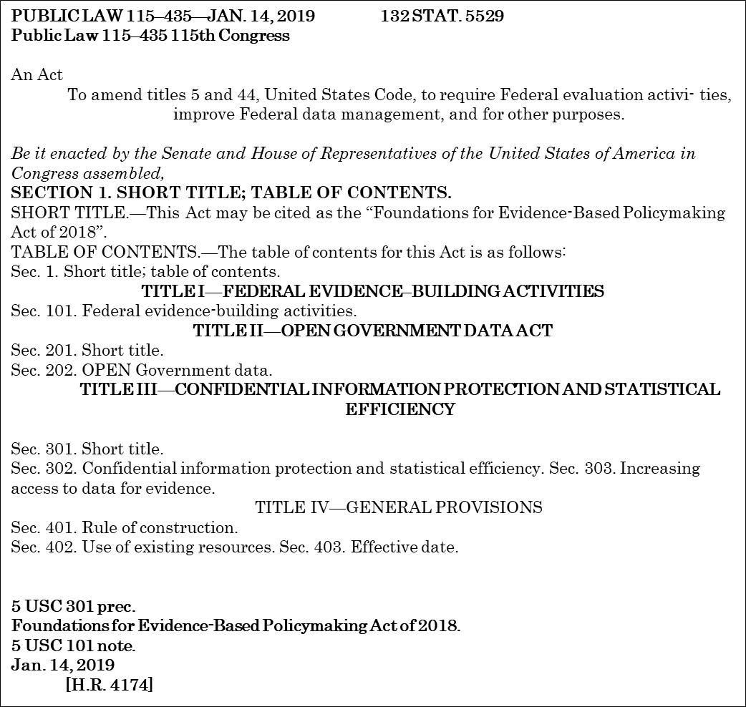
Refresh: Evidence Act of 2018
Foundations for Evidence-Based Policy Making Act of 2018
Recommendations from the U.S. Commission on Evidence Based Policy Making
Three Titles:
I. Federal Evidence Building Activities
II. Open Government Data Act
III. Confidential Information Protection and Statistical
Efficiency Act
.

Slide 64
Initial OMB Guidance
M-19-23: Phase 1 Implementation of the Foundations for Evidence-Based Policymaking Act of 2018: Leaming Agendas, Personnel, and Planning Guidance; July 10, 2019
https://www.whitehouse.gov/wp-content/uploads/2019/07/M-19-23.pdf
M-20-12: Phase 4 Implementation of the Foundations for Evidence-Based Policymaking Act of 2018: Program Evaluation Standards and Practices; March 10, 2020
https://www.whitehouse.gov/wp-content/uploads/2020/03/M-20-12.pdf
M-21-27: Evidence-Based Policymaking: Learning Agendas and Annual Evaluation Plans; June 30, 2021 https://www.whitehouse.gov/wp-content/uploads/2021/06/M-21-27.pdf
OMB Circular A-11: Preparation, Submission, and Execution of the Budget; Section 290:
Evaluation And Evidence-building Activities, August 11, 2023
https://www.whitehouse.gov/wp-content/uploads/2018/06/s290.pdf
OMB Circular A-130: Managing Information as a Strategic Resource,
https://www.whitehouse.gov/wp-content/uploads/legacy_drupal_files/omb/circulars/A130/a130revised.pdf
/

Slide 65
Title 1 – Federal Evidence-Building Activities
Title I Federal Evidence Building Activities
Agency Learning Agendas and Evaluation Plans
Advisory Committee on Data for Evidence-Building
Capacity Building: Chief Evaluation Officer

Slide 66
M-21-27 Learning Agendas
“OMB expects agencies to use evidence whenever possible to further both mission and operations, and to commit to build evidence where it is lacking…
OMB strongly believes that implementing the Evidence Act is not a compliance exercise, and that agencies should develop the required Title I deliverables (i.e., the Learning Agenda, Annual Evaluation Plan, and Capacity Assessment for Statistics, Evaluation, Research and Analysis) in a way that fulfills their purpose as strategic, evidence-building plans…”.
https://www.evaluation.gov/evidence-plans/learning-agenda/

Slide 67
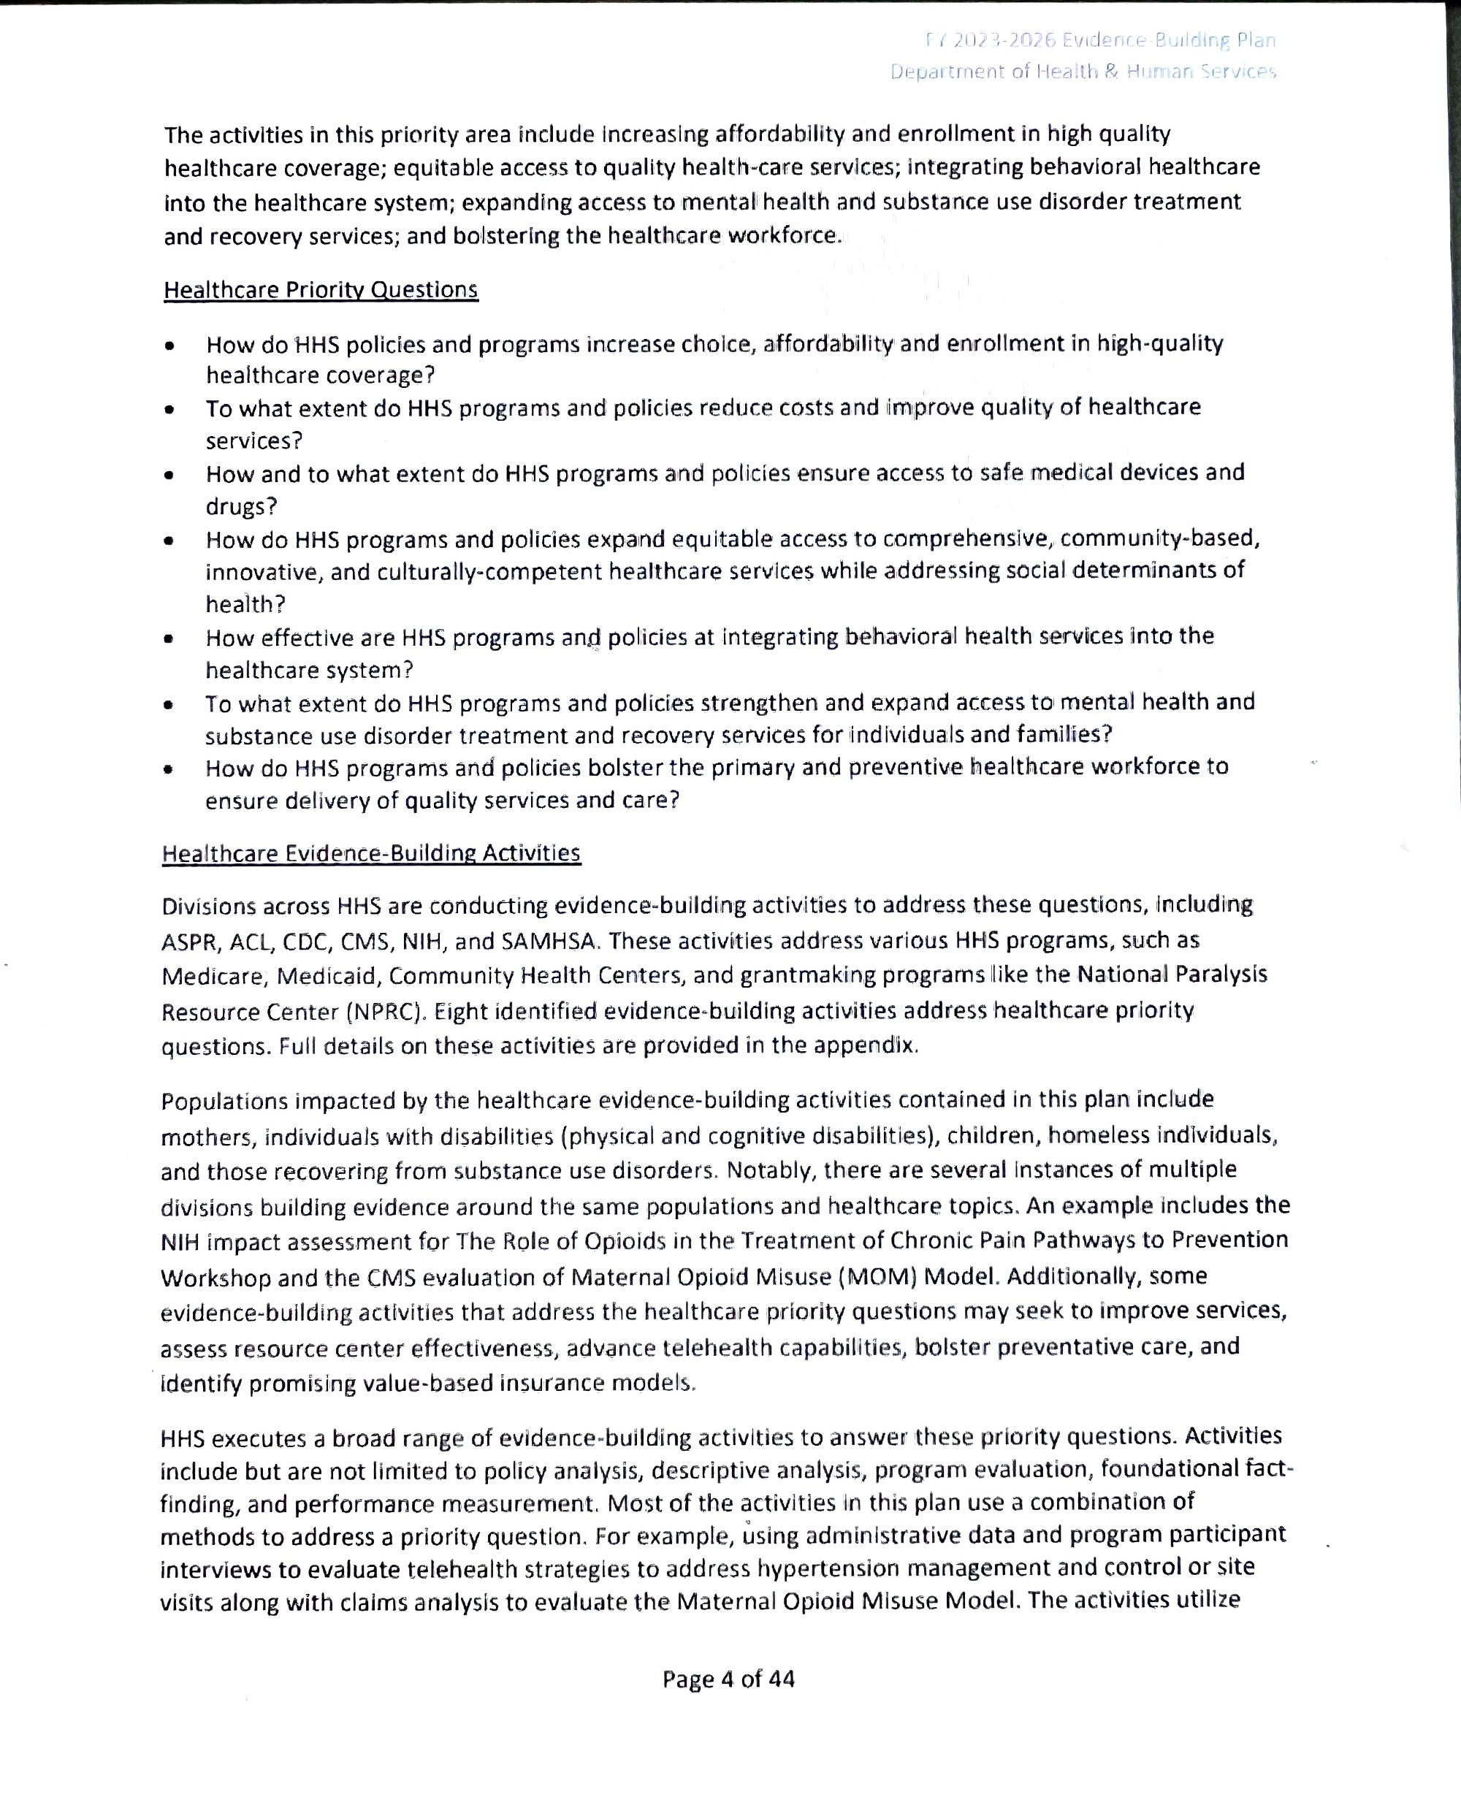
Health and Human Services Learning Agenda

Slide 68
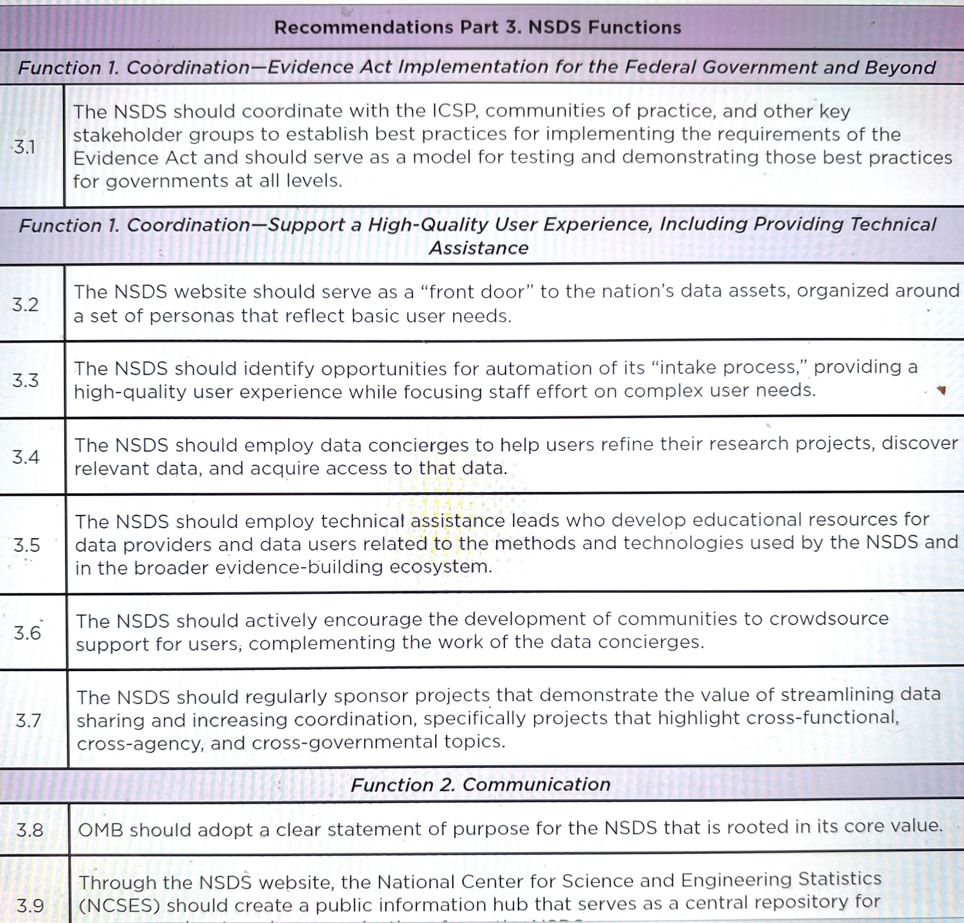
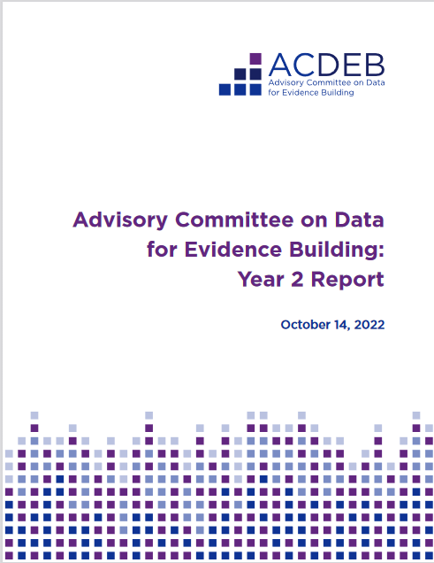
National Advisory Committee Report

Slide 69
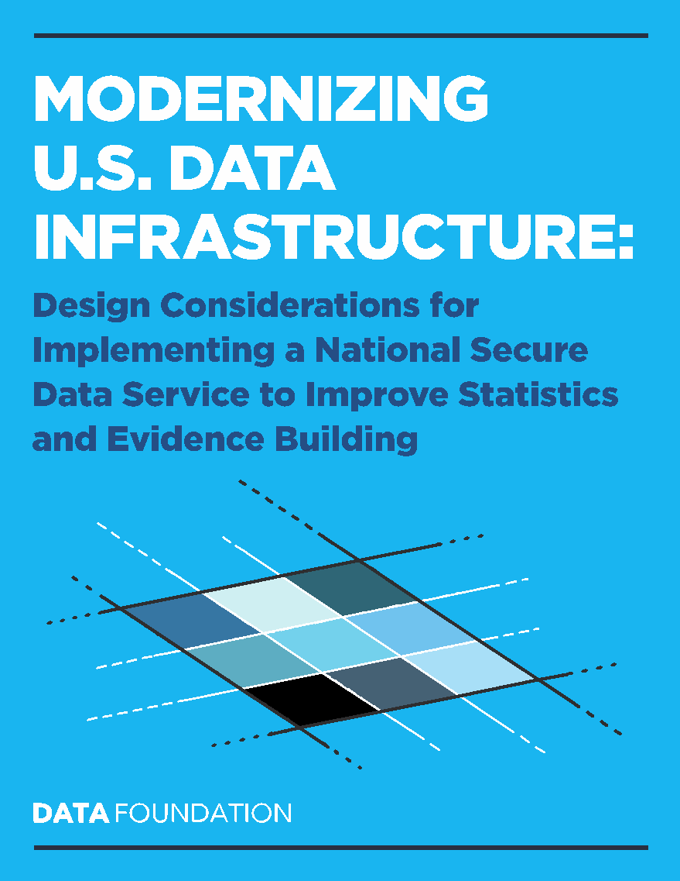
Designing a National Secure Data Service
Analysis of Alternatives
White Paper to Inform the Advisory Committee
Datafoundation.org

Slide 70
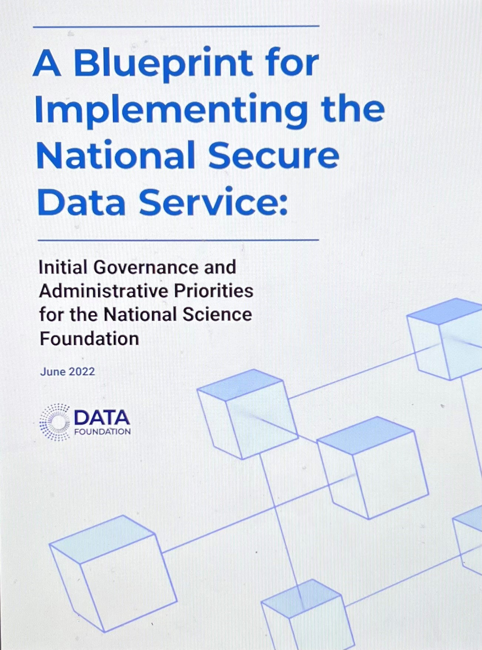
Ideas from Draft Paper
Follow up paper to Modernizing U.S. Data Infrastructure, published by The Data Foundation (Nick Hart co-author)
Provides a specific blueprint for NSDS implementation, including structure, governance, and activities in several key areas
Recognizes the core activities of an NSDS include hosting a secure infrastructure where researchers would: (1) submit proposed research projects for approval; (2) link and access data for research and analyses; and (3) have research results privacy protected then prepared for public dissemination
Offers options for how the NSDS might get started around its core functions to enable later expansion, but most importantly offers a blueprint for how NSF can begin this work quickly, efficiently, and transparently.

Slide 71
Vision for the NSDS: Coordinating Data Hub
Research Node
Hub that is part of a network in which it plays the central role of coordinating a group of nodes that make up a collaborative system guided by a coherent body and governance process.
Research Node
Research Node
Research Node

Slide 72
Important Infrastructure Attributes
Efficient, transparent, and timely business processes are essential elements for a successful NSDS. The NSDS should not become a bottleneck
host the application and approval process; enforce standards
provide core services
continue to develop new tools for privacy protection, search and discovery of data usage, quality measurement
Serve as a catalyst for collaboration
identify where agency policies are creating bottlenecks and assist agencies in finding more efficient approaches to meeting their requirements

Slide 73





CHIPS and Science Act of 2022: SEC. 10375 National Secure Data Service
Authorizes NSF to establish a National Secure Data Service pilot
Charged with developing, refining, and testing models to inform a full service NSDS
Authorizes USD $9 million per year 2022-2026 (total $45 million)
Requires pilot be set up within one year of enactment
America’s Data Hub is home for the pilot https://www.americasdatahub.org/

Slide 74
America’s Data Hub Consortium: Pending Awards
Secure Compute Environment Scan (SCE)
Creation of Synthetic Data for the Annual Business Survey (ABS) and Use of Verification Metrics (ABSSyn)
Models for a Data Concierge Service for a National Secure Data Service (DCS)
Evaluation of Noise Infusion for the Survey of Doctorate Recipients (SDRN)
Utilizing Privacy Preserving Record Linkage to Link Data from Two Federal Statistical Agencies (PPRL1)
Utilizing Privacy Preserving Record Linkage with Parent Agency Data and Statistical Agency Data to Inform Programs and Policies (PPRL2)
Creation of Synthetic Data for the Survey of Earned Doctorates and Development and Use of Verification Metrics (SEDSyn)
Data Usage Platform as a Federal Data Asset (DUP)
Development of a Prototype for the Standard Application Process Portal (SAP)
Expanding Equitable Access to Restricted-Use Data through Federal Statistical Research Data Centers (FSRDC)

Slide 75
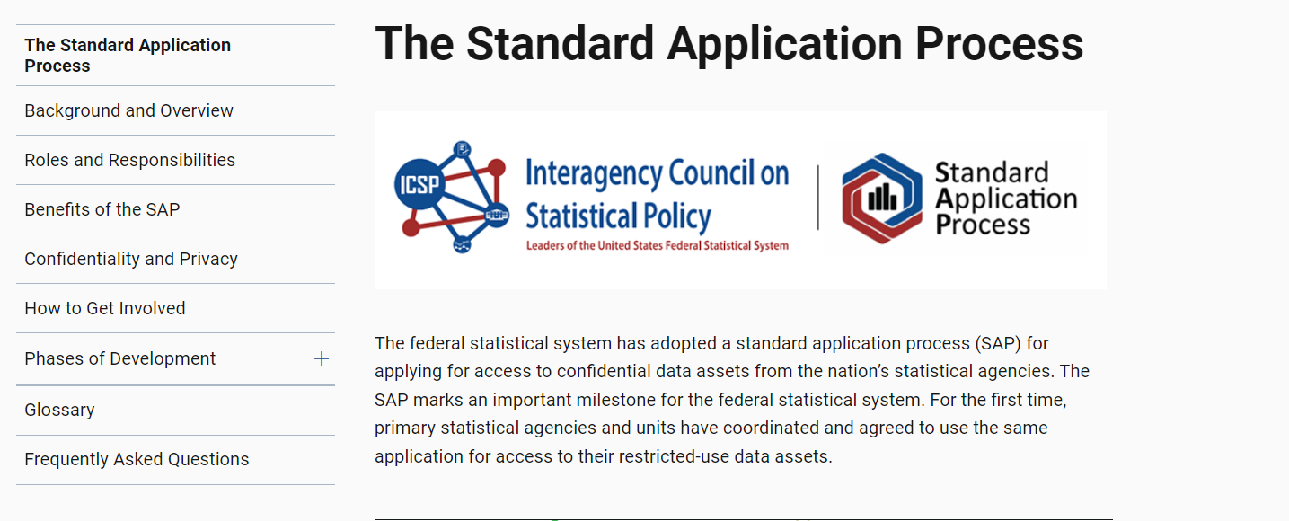
Evidence Act – One Application Mandate

Slide 76
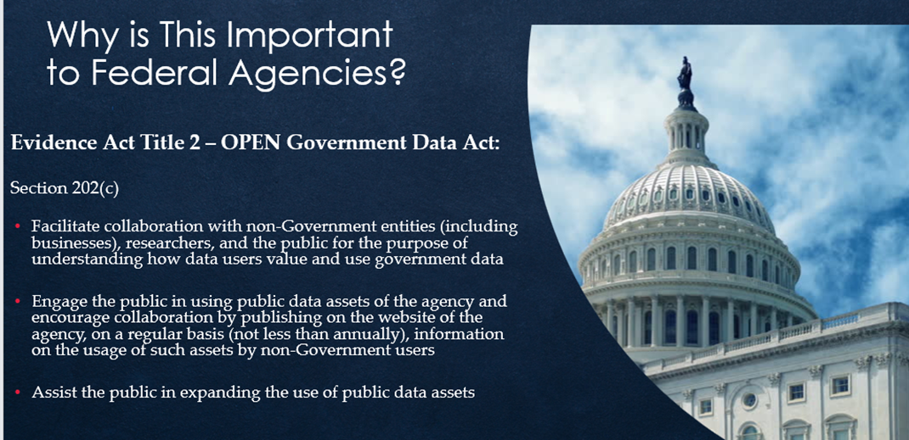
Title 2 - OPEN Government Data Act

Slide 77
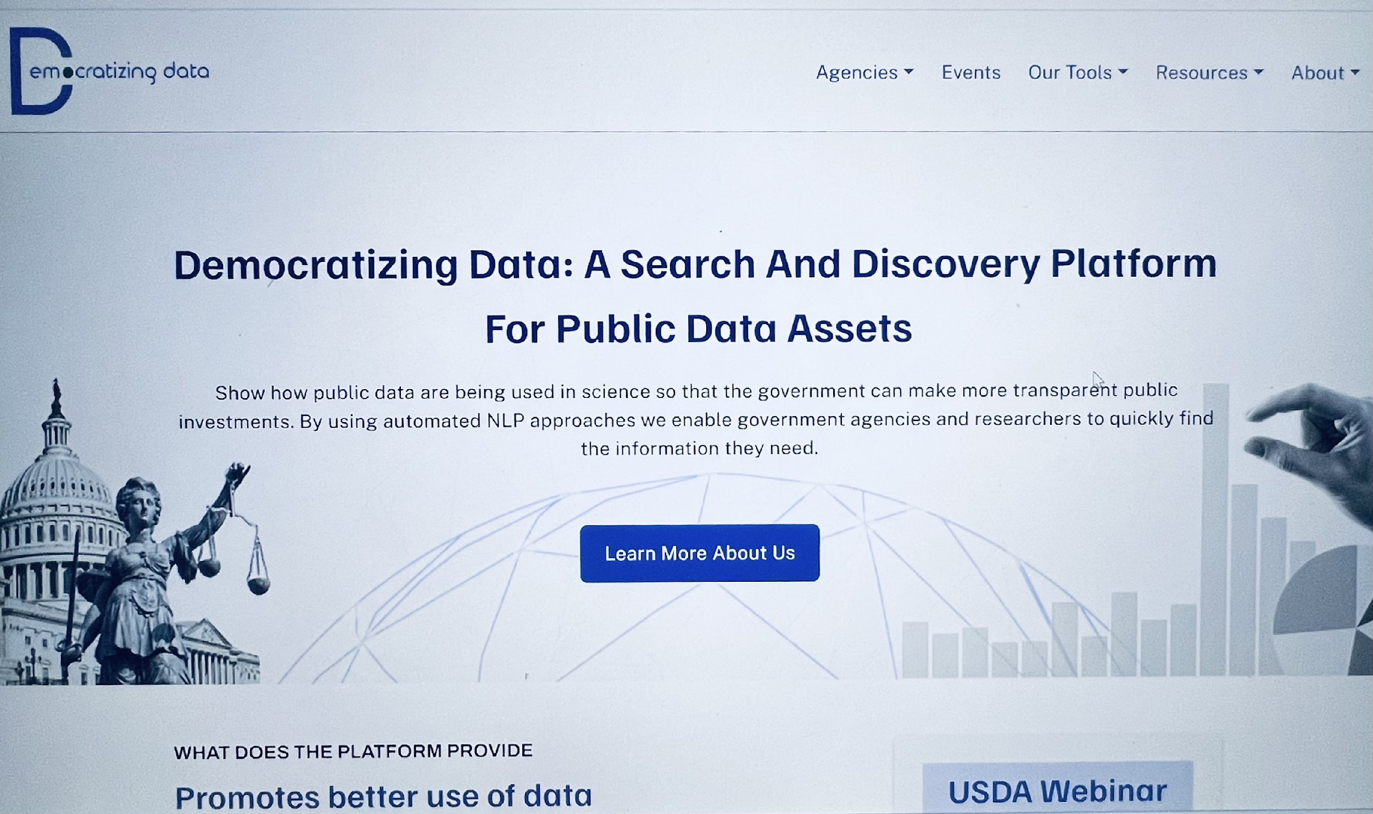
Democratizing Data Search and Discovery Platform
https://democratizingdata.ai/

Slide 78
The Potential for Value-added of a Data Usage Platform as a Shared Service across Federal Agencies
A shared data usage platform with data metrics
Meets the mandates of the Evidence Act for agencies to interact with users
Builds a potential health profile of agency data activities
Enables user communities to connect and partner on research, analysis and application of the data
Supports transparency in data access, data use, and federal data offerings
Builds public trust in official federal statistics and other data

Slide 79
Summary: A Mixed Bag of Results After 5 Years
Guidance in place
NSDS Pilot Underway
Agency personnel in place
Good intentions
Agency culture change is slow
Pandemic delays
Lots of unfunded mandates (not enough money and staff to implement)
Slow but steady progress with much work remaining

Slide 80




Meaningful Data Metrics: The State of Evidence from Bibliometrics Studies on Data Reuse
Moderator:
Stefanie Haustein
Associate Professor, University of Ottawa & co-Director of the ScholCommLab
Nicolas Robinson-Garcia Ramón y Cajal Fellow, University of Granada
Mike Thelwall
Professor of Data Science, University of Sheffield
Thed van Leeuwen
Senior researcher, Centre for Science and Technology Studies of Leiden University

Slide 81
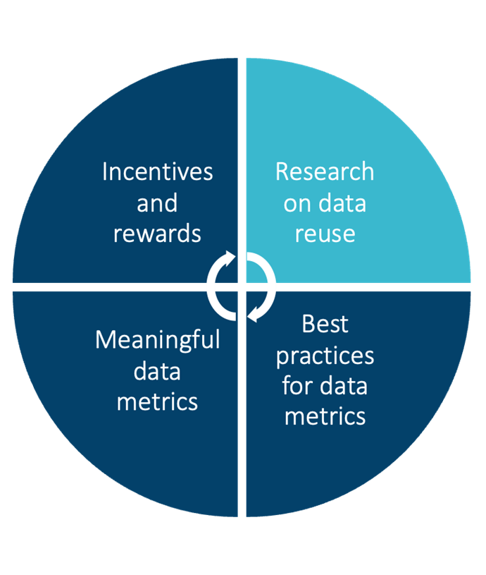

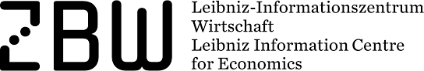

Meaningful Data Counts
Bibliometric analysis of DataCite metadata
Mixed methods approach about data reuse and citation with researchers who do (not) reuse data
Representative survey across academic disciplines (2,492 complete responses)
20 semi-structured interviews

Slide 82
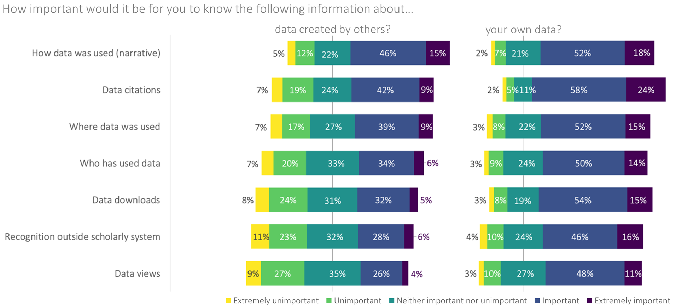
Meaningful Data Counts
Gregory, K., Ninkov, A.B., Ripp, C., Roblin, E., Peters, I., & Haustein, S. (2023). Tracing data: A survey investigating disciplinary differences in data citation. Quantitative Science Studies. https://doi.org/10.1162/qss_a_00264

Slide 83


Meaningful Data Counts
Interview participants on rewarding data sharing
“If it's done right, it's okay. If it's done, like, let's say the h-index then oh my god, please no.”
Postdoc, HCI, Germany
“I don't have time. […] It's not incentivized either [...] so why would I spend some time on something where it really amounts to no recognition [...]. People who are in this community might think I'm a good person […] and that's fine. I can accept that. But I'm not going to track it, necessarily, because it doesn't amount to anything that's recognized.”
Professor, Anesthesiology, Canada
“It's a butt-ton of work to, to package this all up. And so getting a little boost would be nice or [...] a prize [...], it's not going to be citations. But [...] something that would [...] enhance your reputation a little bit.”
Professor, Chemistry, USA
Gregory, K., Boudreau Ninkov, A., Roblin, E., Lawrance, S., Peters, I. & Haustein, S. (2023). Rewarding data sharing and reuse: Initial results of an interview study [preprint]. 27th International Conference on Science, Technology and Innovation Indicators (STI 2023).https://dapp.orvium.io/deposits/643e56dcb62a3e4bb8142ec2/view

Slide 84
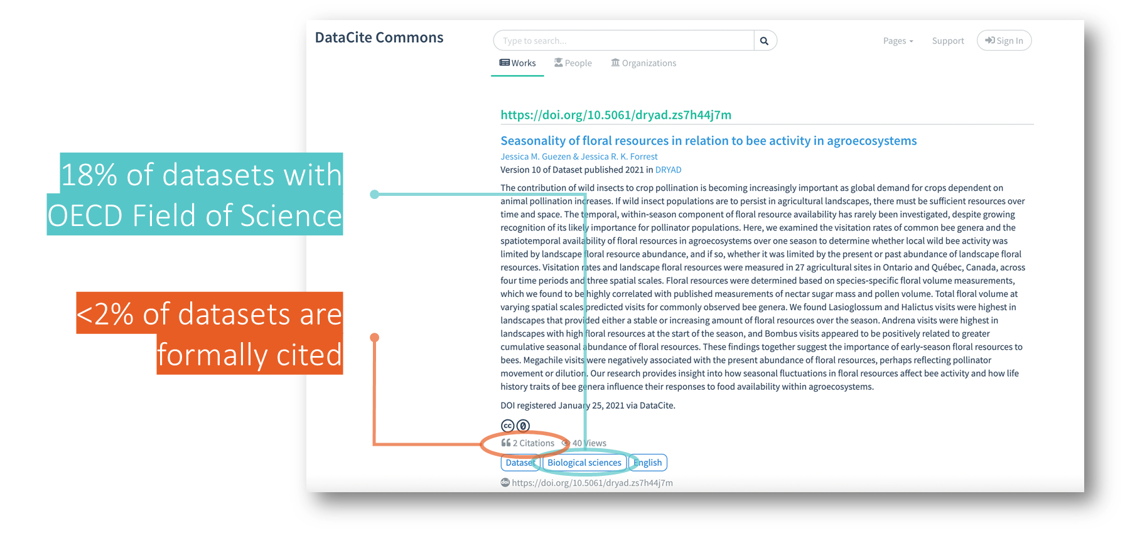
Meaningful Data Counts
Data generated in May 2023 with Jupyter Notebook: Ninkov, A. (2021). antonninkov/ISSI2021: Datasets on DataCite - an Initial Bibliometric Investigation (1.0). Zenodo. https://doi.org/10.5281/zenodo.5092301

Slide 85
Data sharing and reuse practices
We need to explore data sharing and reuse practices in the context of research. Need studies at the individual and team levels
Can we expect everyone to produce and share data?
Task distribution is increasing as Big Science expands to all fields - 4,025,985 researchers in ORCID reporting any type of output - 13,902 (0.003%!!) report producing datasets (many reasons for this, not only motivational)
Differences on data sharing cannot only be explained in terms of fields, it is also related to teamwork and task specialization

Slide 86
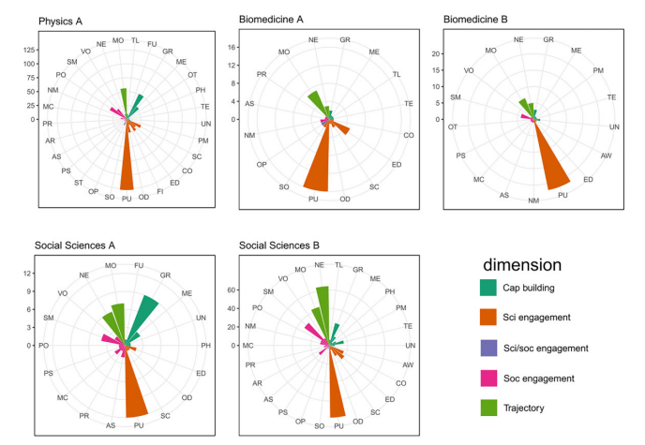
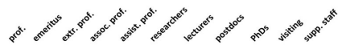
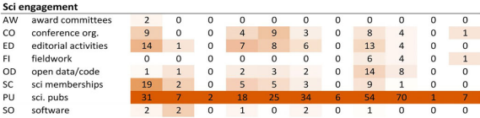
Data sharing and reuse practices
Incentives cannot only come from the outside of the academic system but also form within
CV Analysis in different fields shows that few researchers acknowledge data sharing practices.
Robinson-Garcia, Costas, Nane & van Leeuwen. Valuation regimes in academia: Researchers’ attitudes towards their diversity of activities and academic performance. Research Evaluation, https://doi.org/10.1093/reseval/rvac049

Slide 87
Data sharing and reuse practices
Even though open code and data are increasingly becoming more important, both for funders and researchers, they are still considered as a byproduct of the scientific paper
My personal ambition is [...] scientific achievement. And I think this [sic] is documented in publications, so that would be also my personal ambition, and the software would be a means to an end.
Incentives on data reuse acknowledgement requires researchers to consider it part of the communal knowledge base (peer-reviewed, etc.)
Robinson-Garcia, Costas, Nane & van Leeuwen. Valuation regimes in academia: Researchers’ attitudes towards their diversity of activities and academic performance. Research Evaluation, https://doi.org/10.1093/reseval/rvac049

Slide 88

Measuring the impact of biodiversity datasets & Multidisciplinary survey of data sharing and reuse practices
Nushrat Khan, Institute of Child Health, University College London, UK nushrat.khan@ucl.ac.uk
Mike Thelwall, Information School, University of Sheffield, UK m.a.thelwall@sheffield.ac.uk
Session: Meaningful Data Metrics: The State of Evidence from Bibliometrics Studies on Data Reuse

Slide 89
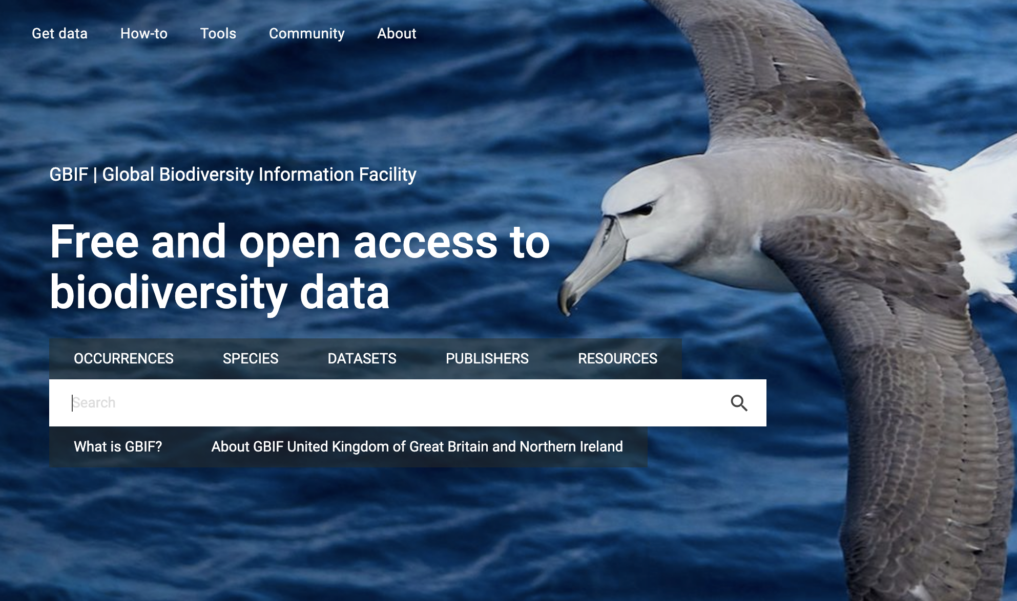
Measuring the impact of biodiversity datasets: Data reuse, citations and altmetrics
Biodiversity data is routinely reused and shared, forming an ideal case study for analysing advanced reuse practices.
GBIF - the Global Biodiversity Information Facility - is an international network and data infrastructure.
Multiple methods to cite data via DOIs and collects citations.
We identified 38,878 datasets in 2018 and randomly sampled 1000.
We found (via GBIF) and analysed 101 articles citing 437 of the 1000 datasets.
We counted blog, Twitter, Facebook and Wikipedia citations to the 38,878 datasets via Altmetric.com
Khan, N., Thelwall, M., & Kousha, K. (2021). Measuring the impact of biodiversity datasets: Data reuse, citations and altmetrics. Scientometrics, 126(3), 3621-3639.

Slide 90
How is GBIF data are reused? Results
Data use cases
82% of citations of GBIF data are (highly diverse) “foreground” use cases (including data papers) and 18% for “background”.
E.g., GBIF + other data to answer questions vs. used for software testing.
Data citation
27% of the sampled articles mentioned the dataset in their reference lists and 13% in data access statements + methods section.
Most articles mentioned the datasets elsewhere: difficult to automatically find and index. (probably why Google Dataset Search found far fewer citations)
Altmetrics
5% of datasets mentioned in blogs, 17% in tweets, 9% on Facebook and 4% in Wikipedia, according to Altmetric.com vs 47% cited according to GBIF.
Conclusion: Data reuse is widespread and diverse in this advanced field but tracking it (to reward data creators) is difficult due to a minority of “correct” citations, although data originating papers may be cited instead.
Initiatives to encourage “correct” data citation practices are thus needed.

Slide 91
Data sharing and reuse practices: Disciplinary differences and improvements needed
Goals: investigate disciplinary differences in data production, sharing and reuse & identify how to promote data sharing and reuse
Methods: Survey of 3,257 first authors of randomly selected publications from 2018 to 2019 in 20 Scopus fields.
Results 1: Data sharing and reuse increasing but not ubiquitous in any field and are more common among experienced researchers.
Results 2: Data types and systematic data sharing varied substantially between fields.
Results 3: Although the use of institutional and journal-supported repositories for sharing data is increasing, personal websites are still frequently used.
Results 4: Combining multiple existing datasets to answer new research questions was the most common use.
Results 5: Researchers in most disciplines struggled to find datasets to reuse.
Khan, N., Thelwall, M. & Kousha, K. (2023). Data sharing and reuse practices: Disciplinary differences and improvements needed. Online Information Review.

Slide 92
Survey recommendations to promote data sharing and reuse
Proper documentation and openness information for data.
Faster application process for protected datasets.
Streamlined ethical guidelines for reused data analysis.
Guidelines for anonymization in medical data.
Support for creator/user collaborations.
Single unified search portal for all data.
Recommendation & alert systems within search portal.
Analysis features integrated within search portal.
Cultural, funding, and policy-related disciplinary changes to increase awareness and acceptance of publishing with “recycled” data.
Formal data citation to reward data sharing.

Slide 93
1 - Before creating Research Data metrics …
Take care research data are managed properly in the first place
Embed research data management, and potentially opening up and sharing of research data, into your Recognition & Reward schemes
Approach openness as “a judicious connection” (Sabina Leonelli, 2023)
Given ‘incompleteness by definition’, research data metrics will always suffer from being proxies
Think carefully what ‘quality’ means related to research data (management)
The philosophy of Open Science, Sabina Leonelli, Cambridge University Press, 2023

Slide 94
2 - Before creating Research Data metrics …
Be aware of commodification and commercialization of (tools regarding) research data management (as happened to publishing, reviewing, etc.)
Be aware of potential metricization and gamification regarding research data (as has happened to publishing)
Realize that policies will always run the risk of unexpected, unforeseen and even adverse effects (as has happened with Gold OA publishing)

Slide 95
Meaningful Data Metrics
What do we need to create meaningful and responsible data metrics?
How do we avoid repeating mistakes of popular citation metrics?

Slide 96
Make Data Count Summit: What next
Make Data Count is a hub for collaboration - would you like to contribute? Let’s work together
iratxe.puebla@datacite.org
Stay up-to-date on updates from Make Data Count
makedatacount.org/community/
Make Data Count is here to catalyze change, convene communities and stakeholders to drive meaningful data metrics

